Slide 1
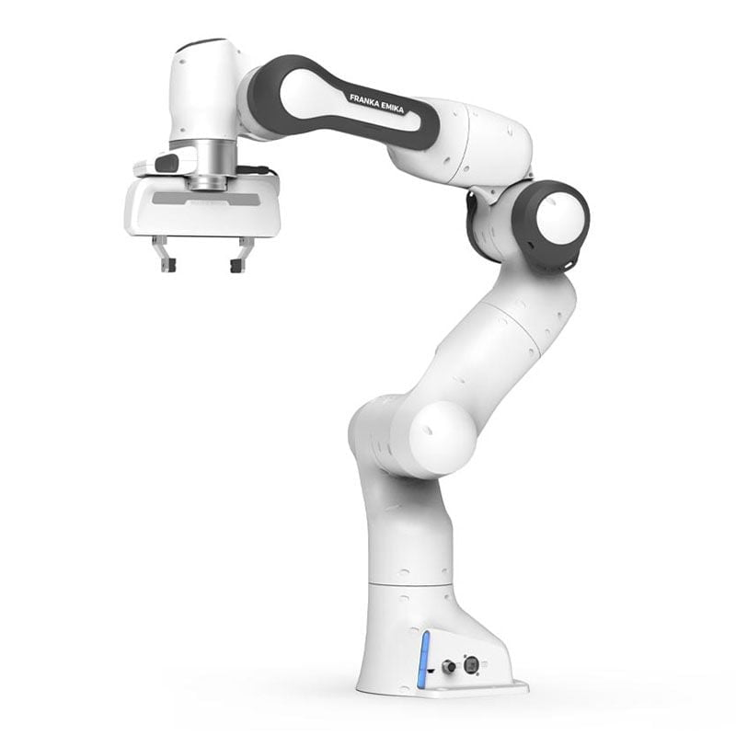
Vision Robotic Arm Gesture Recognition
Emanuele bianchi
Ettore candeloro
Benedetta fabrizi
Gabriele rosati

Slide 2

The idea
Goal: use gestures and body movements to impose a motion to our robot
Two main parts:
Vision algorithm
Robot simulation and movement

Slide 3
Why this project?
We wanted to combine computer vision algorithms and robotics to create a proof of concept application
Controlling remotely a robot can be useful in dangerous environments, for medical assistance and for simulation/testing

Slide 4
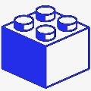
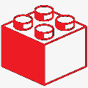
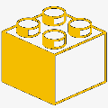
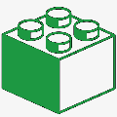
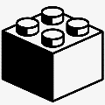
Building Blocks
Block 1
Computer Vision: Hand Detector + Pose Detector
Block 2
ROS + Gazebo
First basic manipulator
Hand aperture robot control
Block 3
MoveIt
Rviz
Panda - Franka Emika
MoveIt vs Gazebo
Block 4
Direct Kinematics
Final Prototype
Block 5
Future Improvements

Slide 5
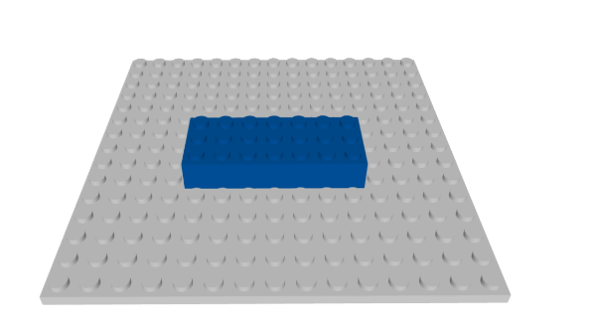



Building Blocks
Vision algorithm
We used Python with the OpenCV and MediaPipe libraries.
OpenCV allows us to work with images and video and use CV algorithms.
Mediapipe is an ensemble of ML algorithms for different purpose developed by Google. In our case we exploit it for Hand and Pose detection. It is efficient and works also in CPU mode. This means is also employable for mobile devices.
Block 1

Slide 6
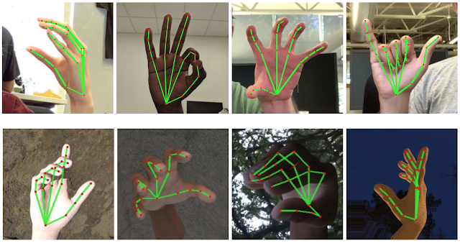

Building Blocks
Hand Detector
Our HandDetectorModule computes 21 hand keypoints (as shown in figure) given a webcam image.
After the detection, custom made class methods are used to find the hand keypoints in 2D and/or in 3D and compute the hand aperture.
Block 1

Slide 7
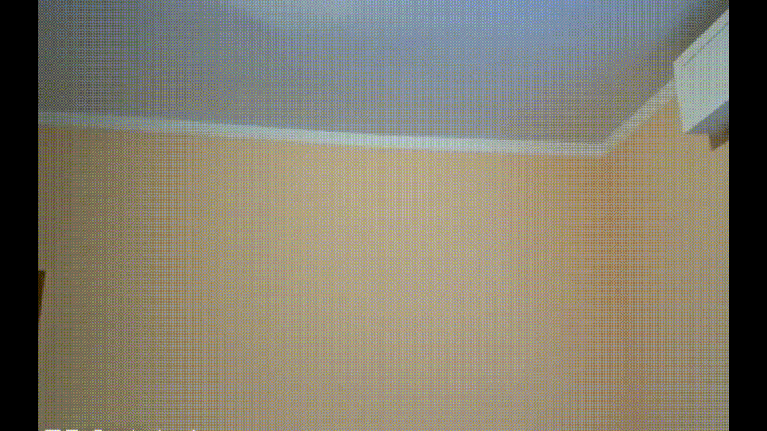
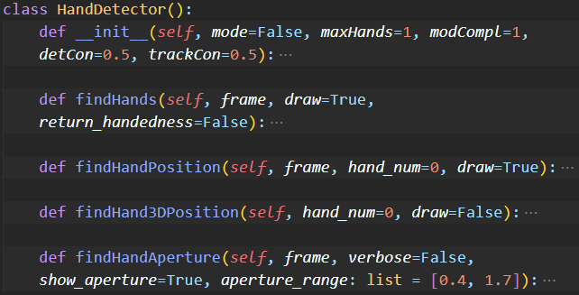
Building Blocks
Hand Detector Module Showcase
The HandDetector class is composed of the following methods:
Block 1

Slide 8
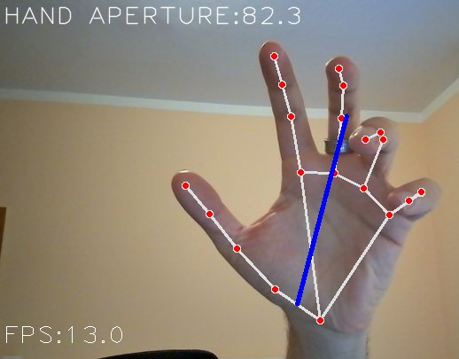
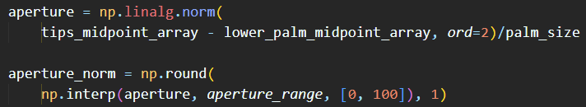
Building Blocks
Computing the hand aperture
The four hand index tips are located, along the base of the hand (middle point between wrist and thumb base)
The median point between the fingers tips (thumb excluded) is computed
The L2 distance between the base of the hand point and the median fingers position is computed
The distance is then normalized by the palm size and remapped between the value 0 and 100
Block 1

Slide 9

Building Blocks
Pose Detector
Our PoseDetectorModule computes 33 body/pose key-points (as shown in figure) given an input image
After the detection, various class methods are used to compute the keypoints 2D and/or 3D position and the angle between a set of 3 keypoints.
We use those (pose) angles to modify the joint position values of our robot, so that we can control it via specific movements.
Block 1

Slide 10
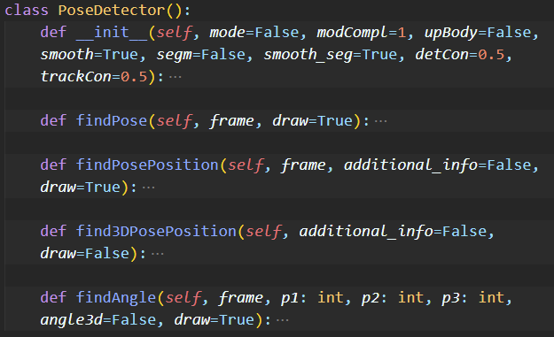
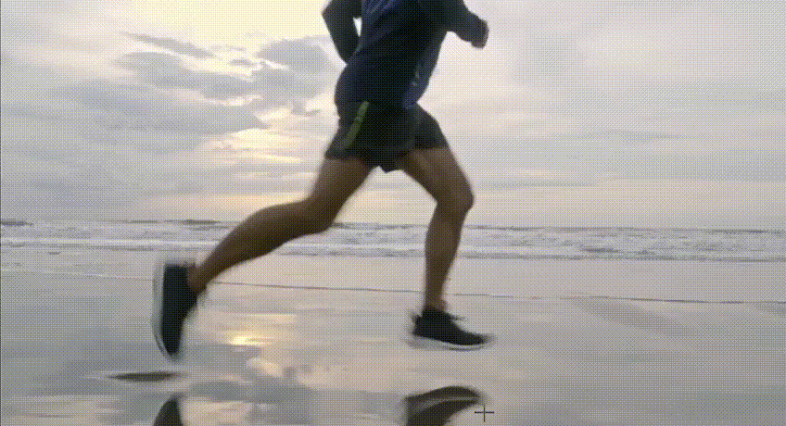
Building Blocks
Pose Detector Module Showcase
The PoseDetector class is composed of the following methods:
Block 1

Slide 11
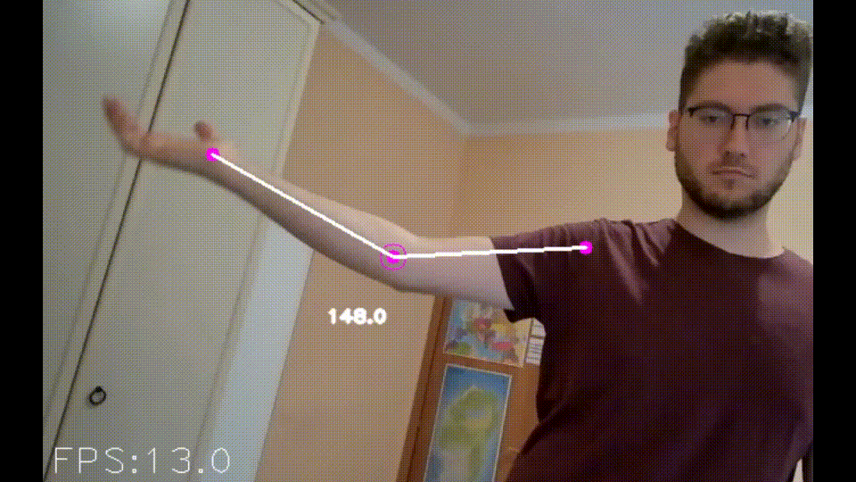
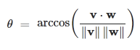
Building Blocks
Extracting pose angles
To extract the angles between a set of 3 keypoints (like the elbow angle given the points 12, 14, 16) we make use of the property of the scalar product between two vectors.
We create two vectors with the same origin (at the central keypoint, where we want to know the angle value)
We use the following formula to compute the angle between those two vectors:
With this method we can consider both the 2D and 3D keypoints for more robustness!
Block 1

Slide 12
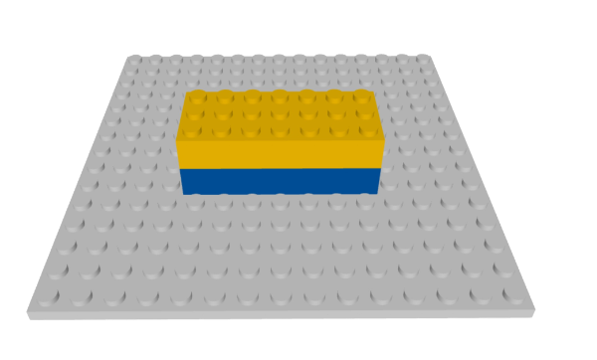
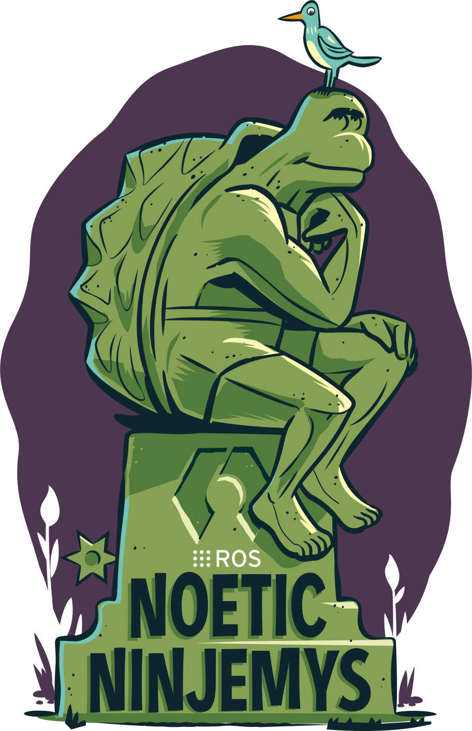
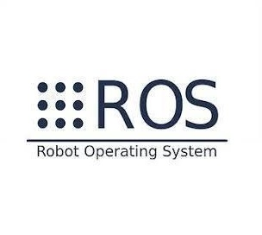
Building Blocks
Robot Environment
Robot Operating System (ROS) is a framework for developing and programming of robots.
It provides tipical base services of every operating system like hardware abstraction, drivers for devices, process management, etc.
ROS is not natively real time
Different versions exixst, we choose ROS Noetic
Block 2

Slide 13

Building Blocks
Gazebo
Gazebo is one of the simulation environment used with ROS
It's fast, light and has a big community of users
Gazebo allows Pub/Sub mechanism of ROS
Each joint can have one or more topics and it is possible to publish on topics (e.g. modify joint values in real-time)
Block 2

Slide 14
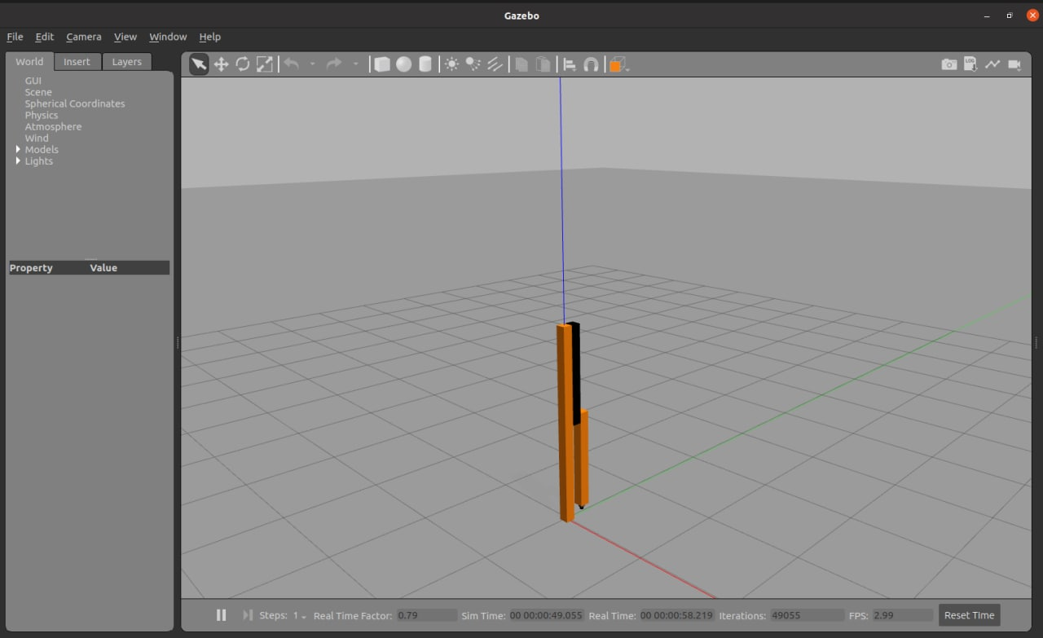
Building Blocks
Gazebo + ROS
The first robot has only 2 DOF (2 rotational joints)
The joint's values are modified with the aperture value of one human-hand provided by the Hand Detector.
Block 2

Slide 15
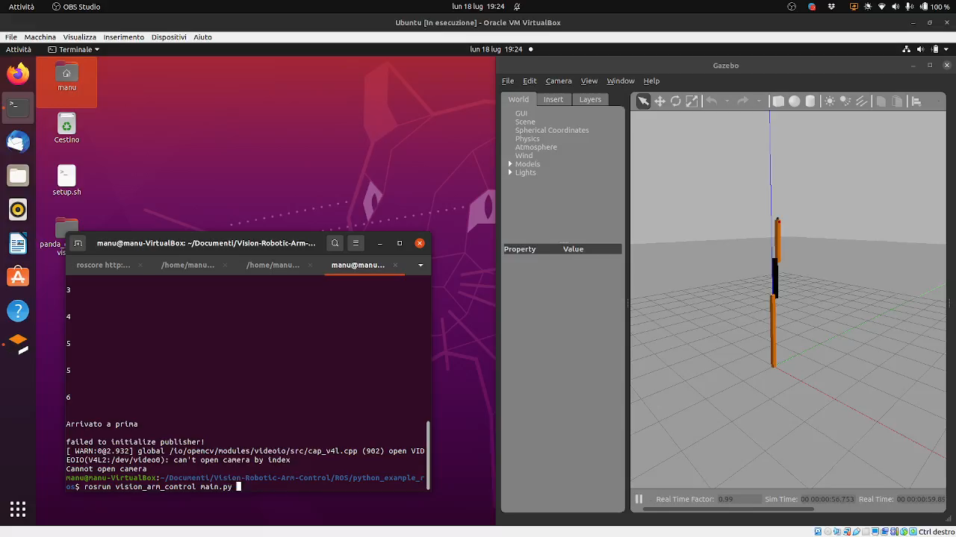
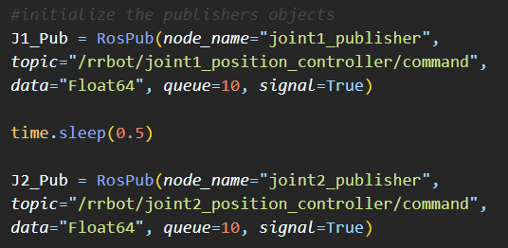
Building Blocks
Gazebo + ROS Demo
For running the simulation and script we need to launch:
Roscore
Gazebo world
Robot controllers
main.py
Block 2
Notes:
Roscore is a collection of nodes and programs that are pre requisite of a ros base system, you must have a roscore running in order for ros nodes to communicate

Slide 16
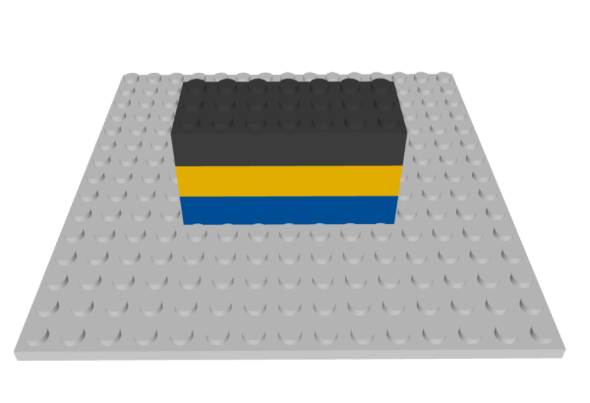

Building Blocks
MoveIt
MoveIt is an open-source robotic manipulation platform that allows to develop complex manipulation applications using ROS.
With MoveIt you can plan towards any goal position by:
taking into account the environment scene by avoiding objects.
interacting with the environment by grabbing objects and including them in the planning process.
Block 3

Slide 17
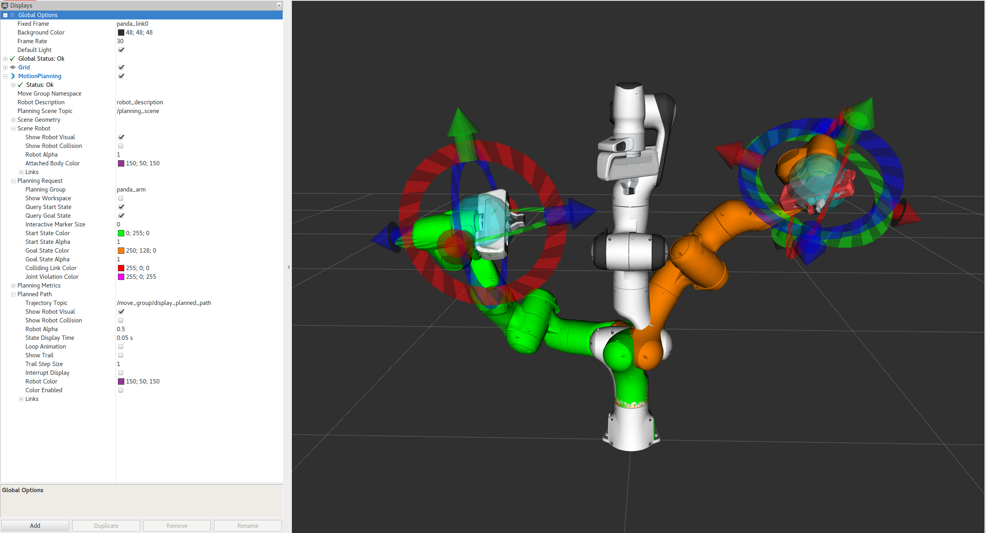
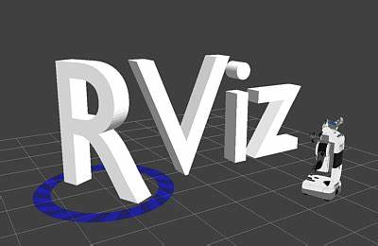
Building Blocks
Rviz
Rviz (short for “ROS visualization”) is a 3D visualization software tool for robots, sensors, and algorithms.
Similar to Gazebo but have a better integration with Moveit.
Block 3
At the end, we did not use MoveIt and Rviz due to performance issues on our implementation.

Slide 18
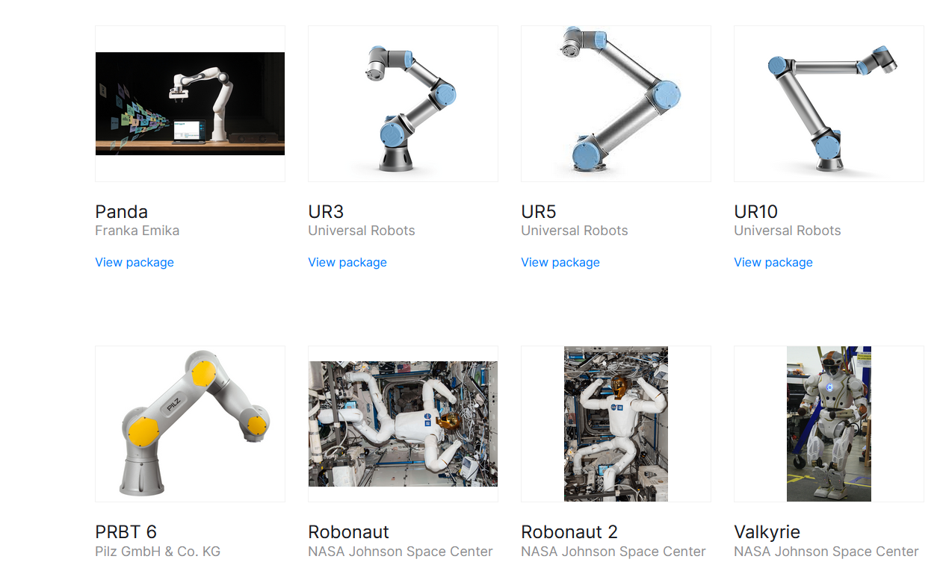
Building Blocks
Panda (Franka Emika)
It's an anthropomorphic manipulator with 7 DOF.
Advantages:
It's one of the most used robot in real applications and research.
The arm is inspired by the agility of the human arm.
It’s completely open-source.
(Theoretically) it’s easy to switch between the virtual simulation and the physical application.
Block 3

Slide 19
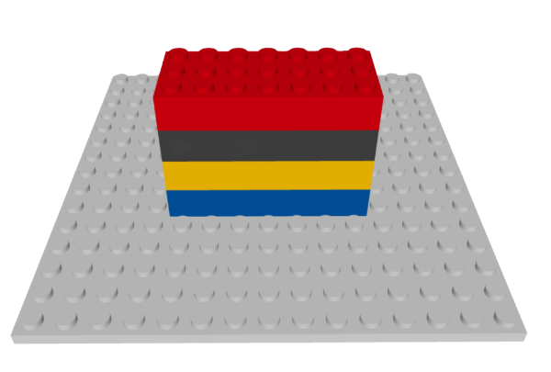
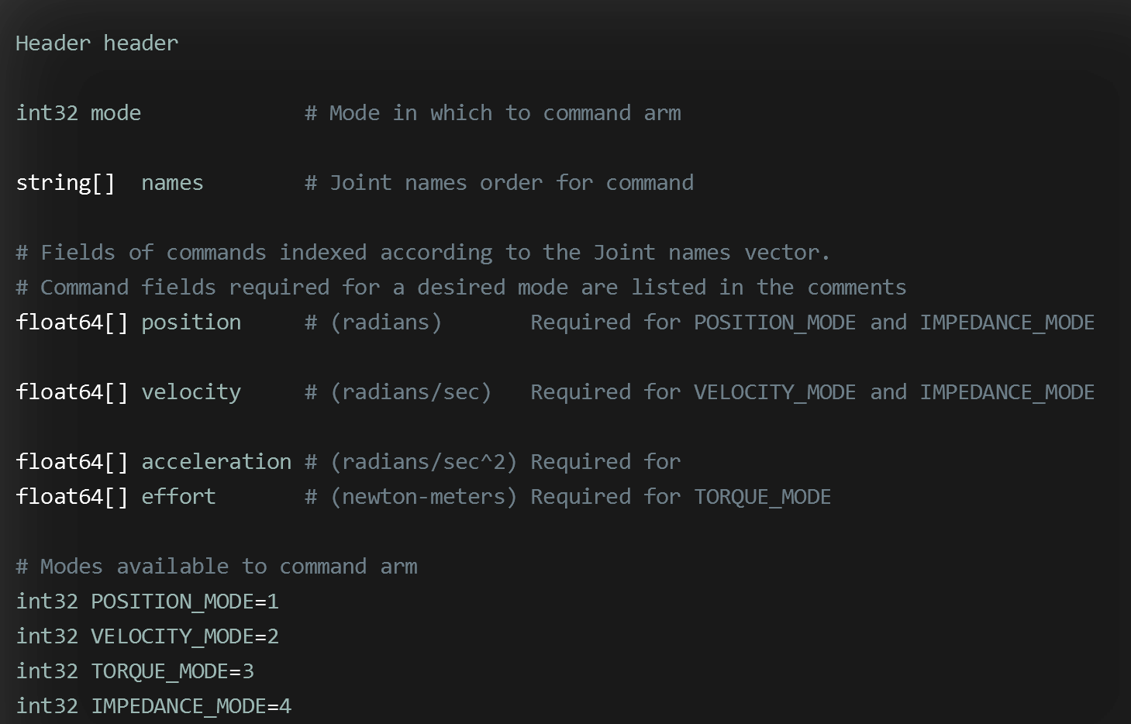
Building Blocks
Final Prototype – Simulation/Control
We used Gazebo + ROS
We used a Direct Kinematics control with Pub/Sub mechanism
we publish in a single Topic with the message of the following format:
Block 4

Slide 20
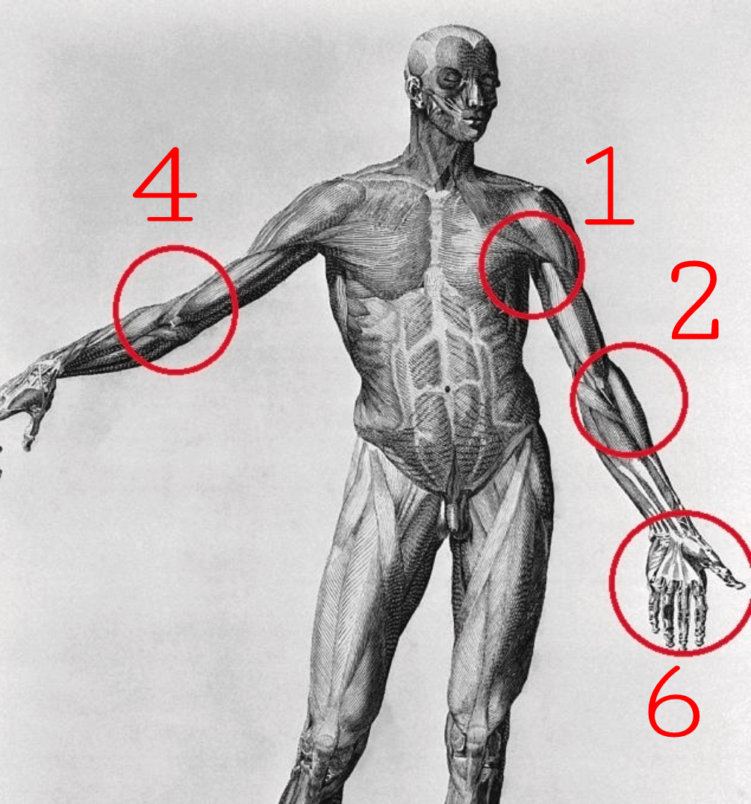
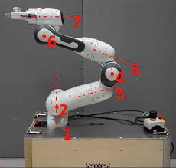
Building Blocks
Final Prototype – Gestures
For moving our robot we use:
One hand for the sixth joint
Right-elbow angle for the fourth joint
Left-elbow angle for the second joint
Left-shoulder angle for the first joint
The other 3 joints are fixed
Block 4

Slide 21
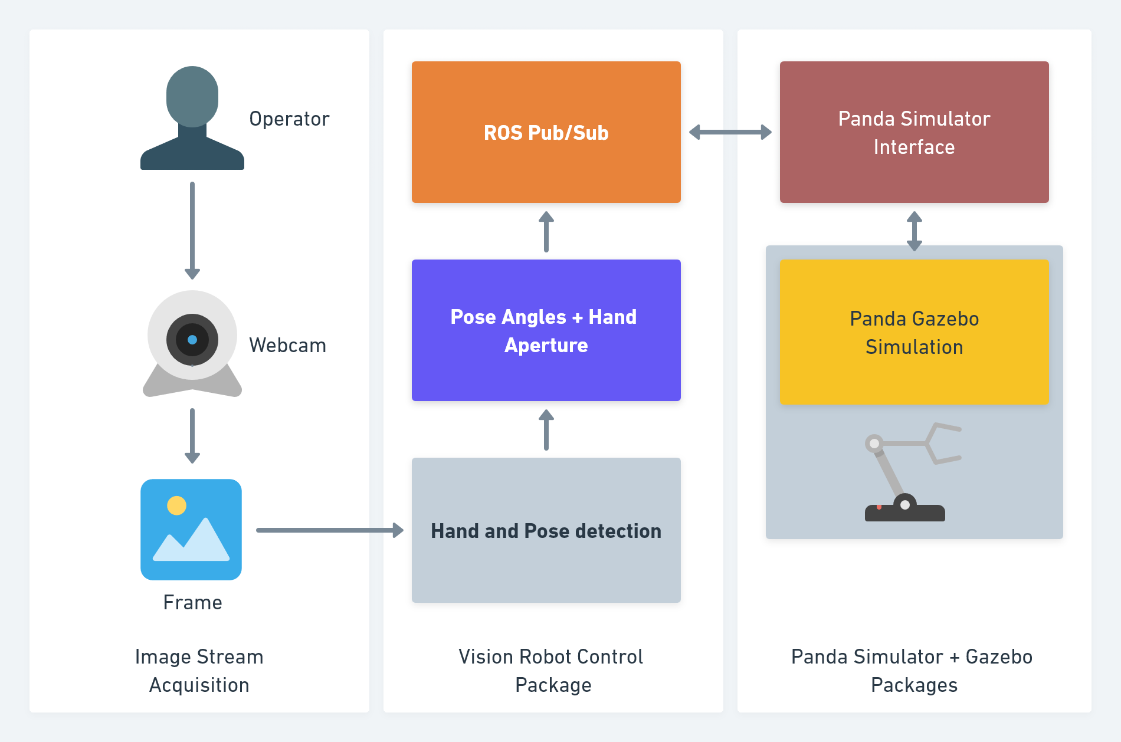
Final High Level Architecture

Slide 22
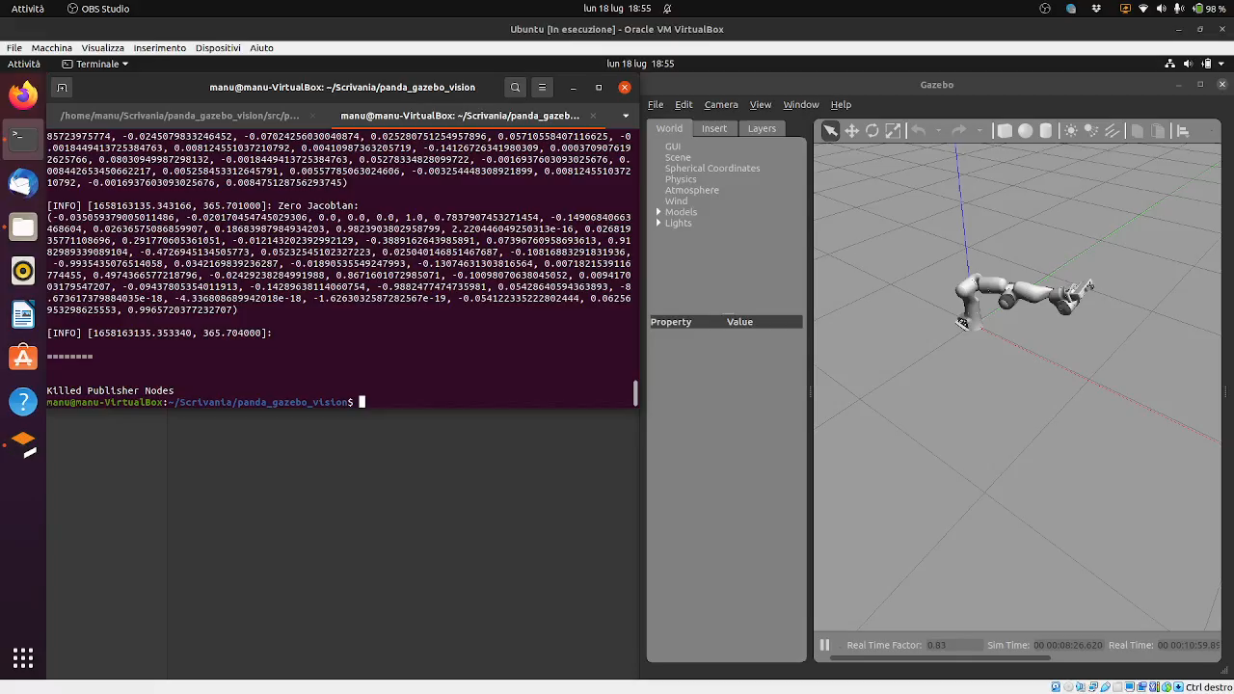
Building Blocks
Final Prototype - Demo
Block 4

Slide 23
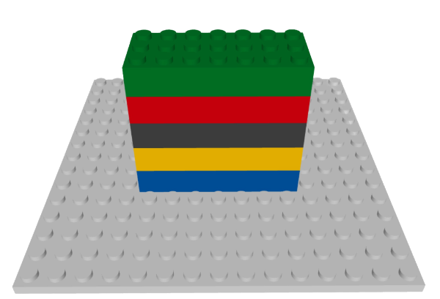
Building Blocks
Future improvements
Gestures complexity and usability: Increase the set of possible gestures by adding different types of movements and improving the usability.
Test the prototype on a high-end machine, then transpose it over a real robot.
Divide each node into a standalone machine, which will be connected to the master nodes remotely.
Improve the connectivity of the solution, by exploiting camera and devices that could be connected remotely.
Block 5

Slide 24
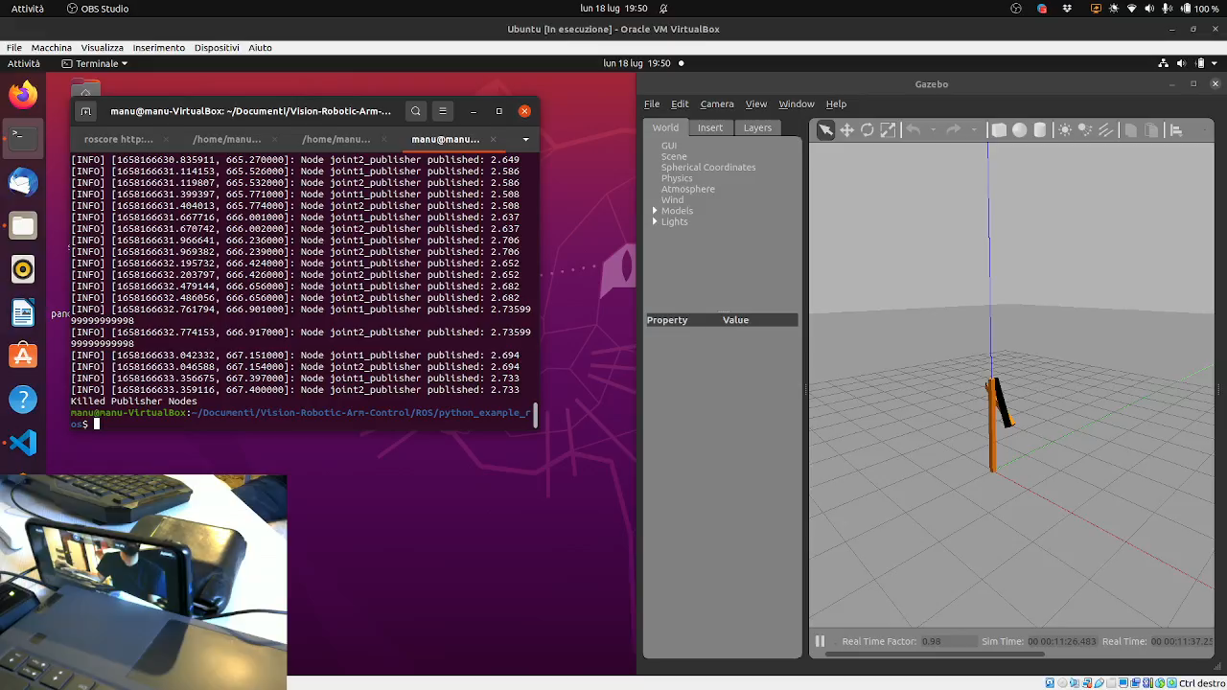
Building Blocks
Block 5

Slide 25
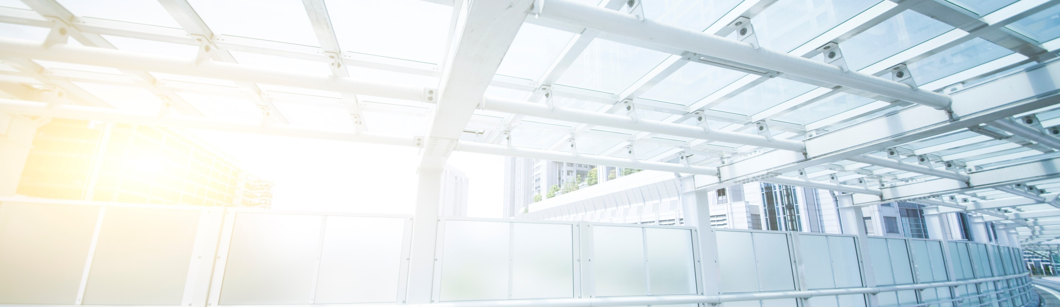
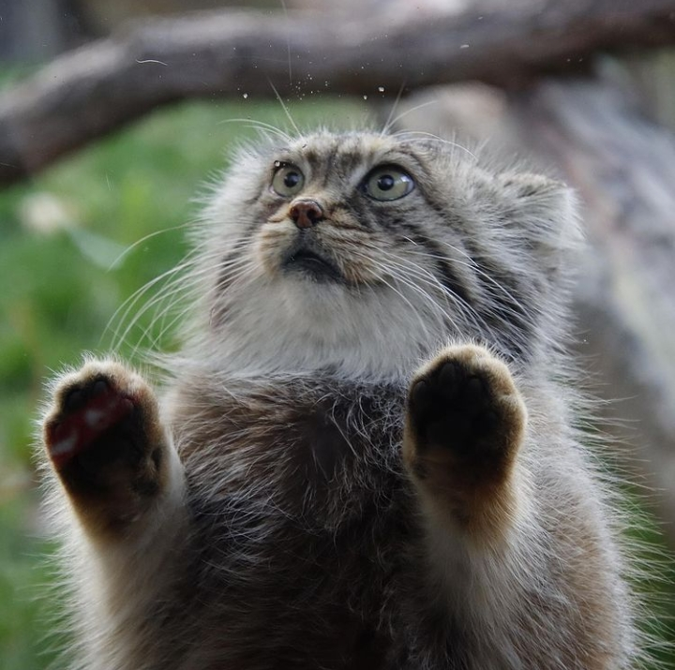
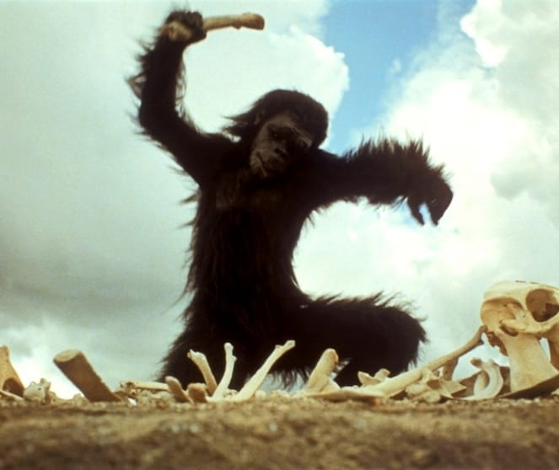
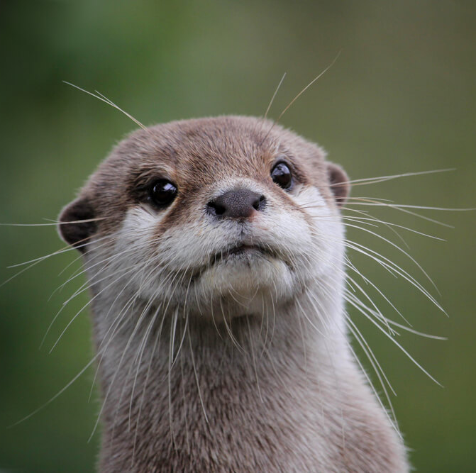
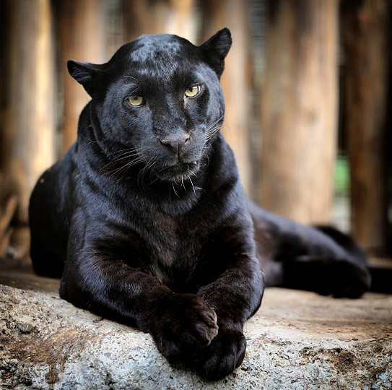
Thanks for your attention!
The team
Emanuele Bianchi
Gabriele
Rosati
Benedetta
Fabrizi
Ettore
Candeloro

Slide 26
Backup Slides 💾

Slide 27
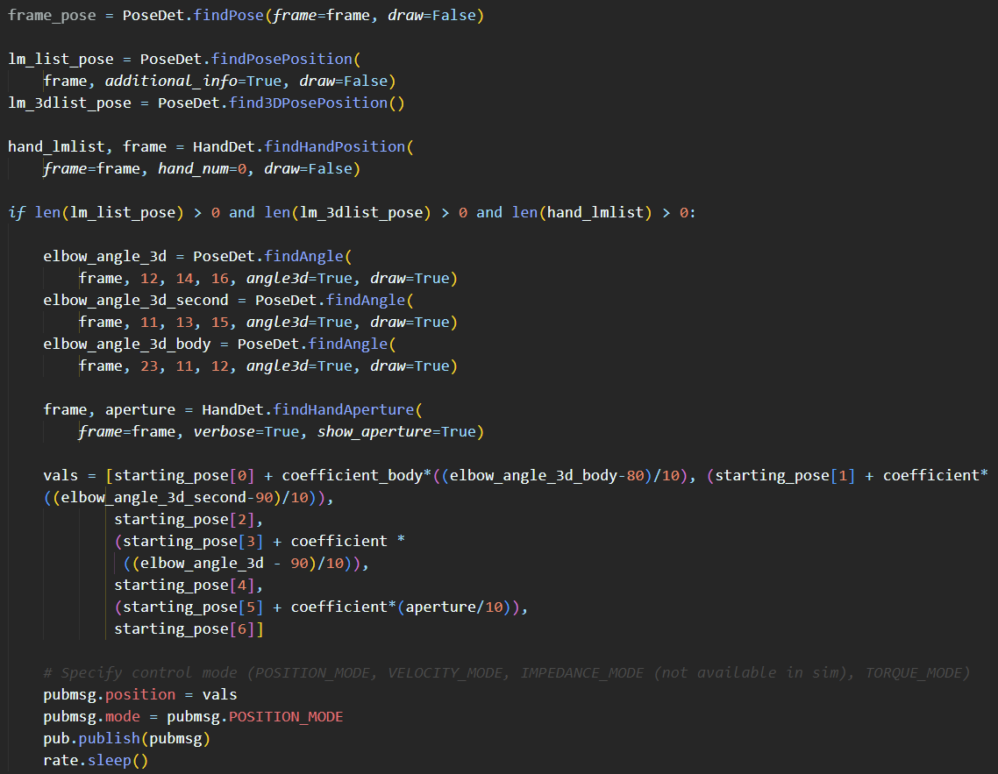
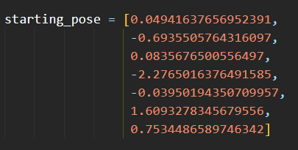
Detection of Hands and Pose
Detection of Hand and Pose keypoints
If the keypoints are detected, extract the the elbow angles and hand aperture
Publish the values (adjusted) to the Panda robot

Slide 28
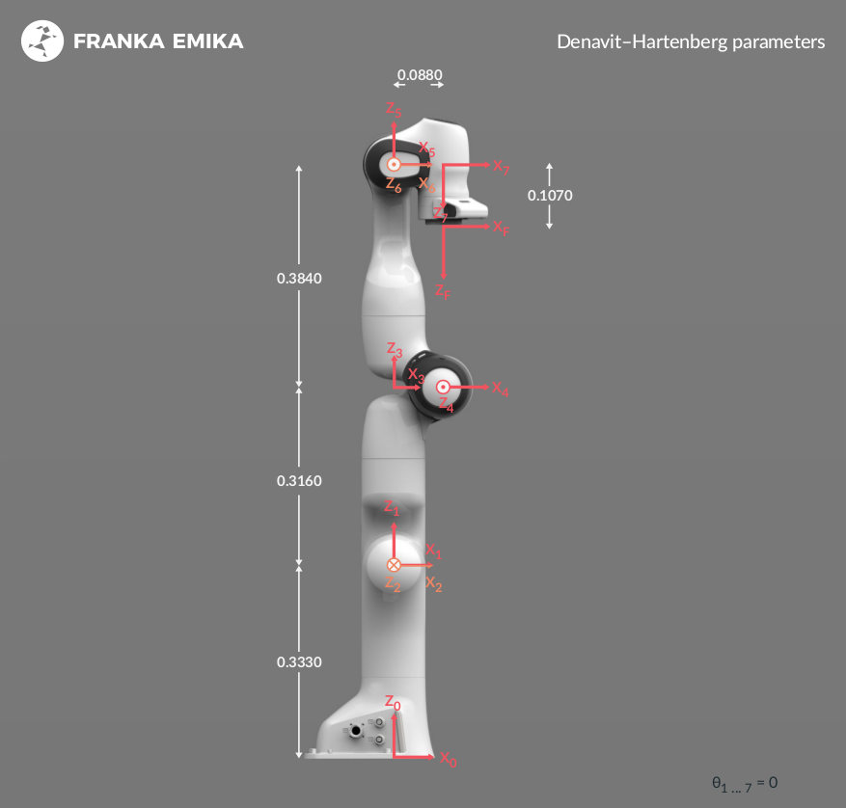
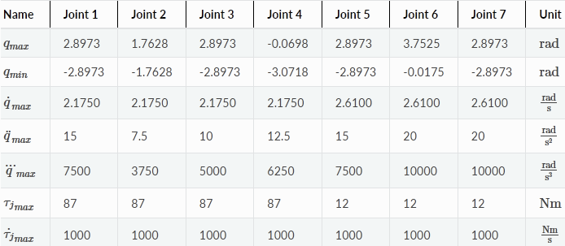
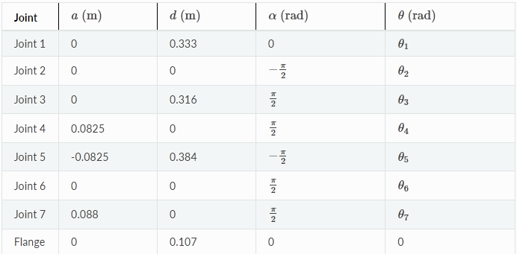
Some Panda’s specs

Slide 29
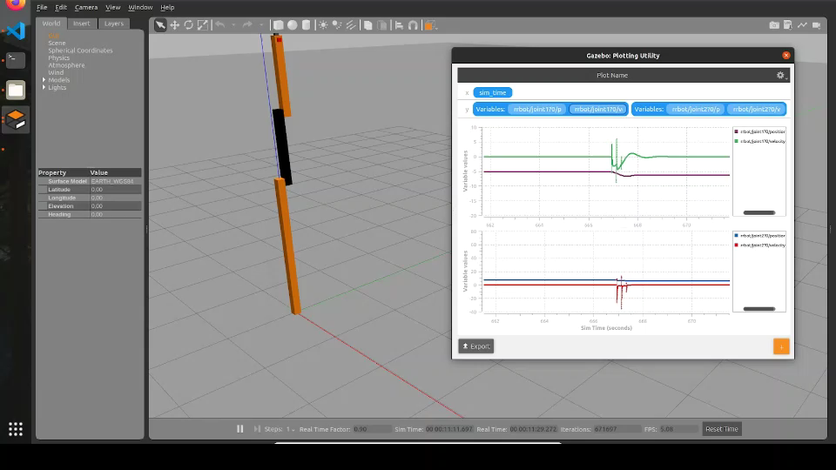
Rrbot control and pid parameters

